Slide 1

SQL Data Analyst Project
HEALTH CARE
The hospital database system's core objective is to improve hospital management by providing a centralized, structured, and efficient system to manage patient records, medical treatments, staff, billing, and other operations.
Reporter: JAYA MAHANTHI

Slide 2
OBJECTIVE :
The hospital database system's core objective is to improve hospital management by providing a centralized, structured, and efficient system to manage patient records, medical treatments, staff, billing, and other operations. By doing so, it aims to:
Enhance patient care through accurate tracking of medical information.
Optimize resource management and staff allocation.
Streamline financial and operational processes.
Ensure regulatory compliance and data security.
Provide decision-making tools through detailed reporting and analytics.
This system aims to foster a more organized, efficient, and transparent hospital environment, ultimately contributing to better healthcare outcomes and smoother hospital operations.

Slide 3
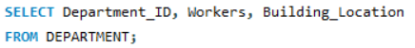
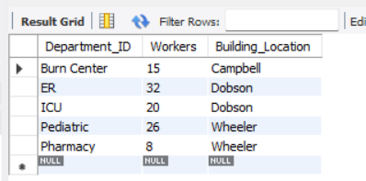
List all departments with the number of workers and their locations?
CODE:
OUTPUT:

Slide 4
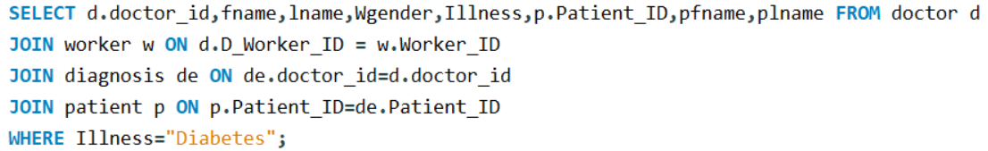
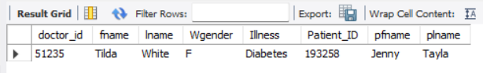
Find the doctor who have treated a patient for "Diabetes"?
CODE:
OUTPUT:

Slide 5
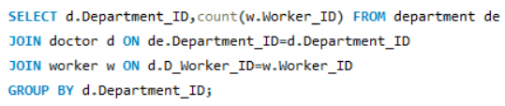
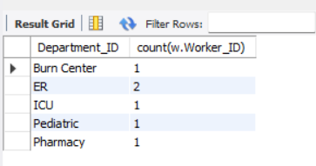
Find the total no.of workers in each department ?
CODE:
OUTPUT:

Slide 6
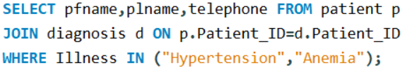
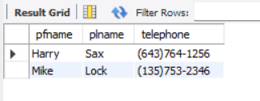
Retrive the names and phone numbers of all patients who have been diagnosed with Illness of Hypertension and Flu?
CODE:
OUTPUT:

Slide 7
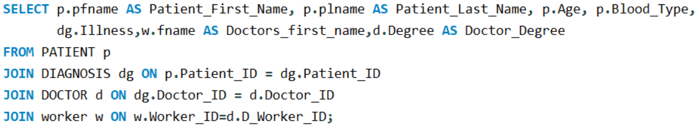
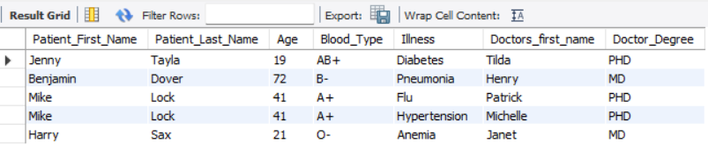
Get the list of patients, their diagnoses, and the doctors treating them?
CODE:
OUTPUT:

Slide 8
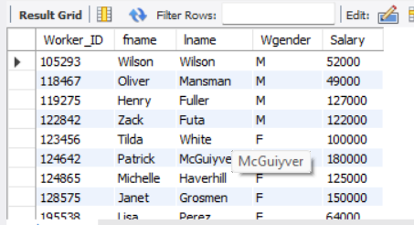

List all workers and find total salary expenditure on them?
CODE:
OUTPUT:
CODE:
OUTPUT:

Slide 9
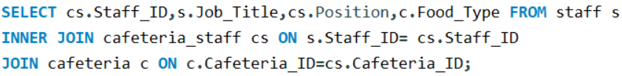
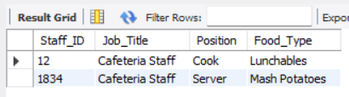
List all cafetaria staff along with their job position and the food type served in their assigned cafeteria?
CODE:
OUTPUT:

Slide 10
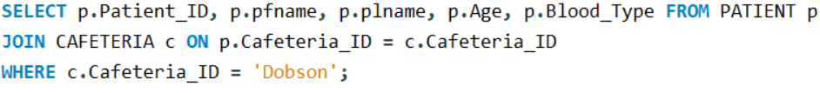
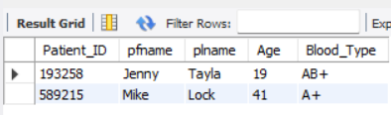
Get the details of the patients admitted to the 'Dobson' Cafeteria ?
CODE:
OUTPUT:

Slide 11
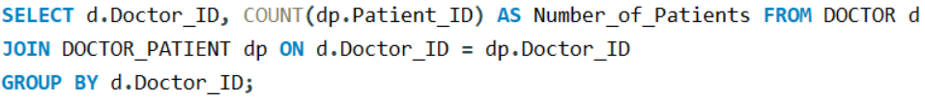
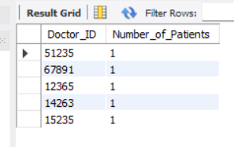
Find the number of patients treated by each doctor ?
CODE:
OUTPUT:

Slide 12
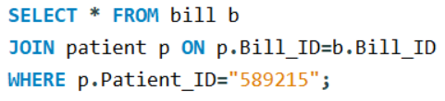
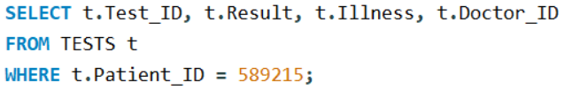
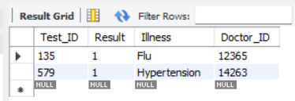
Get the bill details for a patient with Patient_ID 589215 and also the no.of tests conducted on the patient?
CODE:
OUTPUT:
CODE:
OUTPUT:

Slide 13
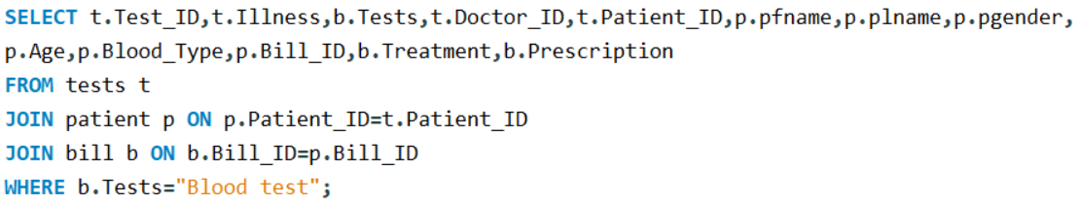
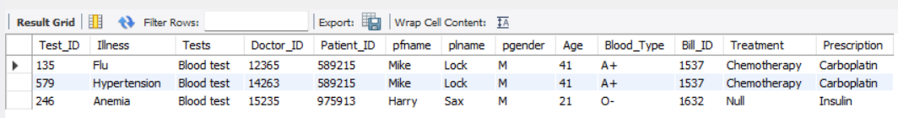
Find the name of the patient who have undergone 'Blood test' and given prescription:
CODE:
OUTPUT:

Slide 14
FINAL REMARKS :
The Hospital Database Management System project fulfills its core objectives of improving hospital data management, patient care, and overall operational efficiency. By leveraging a structured relational database, the system enhances communication, ensures data accuracy, and supports both administrative and clinical decision-making.
This project serves as a valuable tool for any healthcare institution looking to streamline its operations, manage patient and staff data efficiently, and improve the quality of care. The insights gained from this database system lay the foundation for a more organized, data-driven hospital environment, offering the potential for continuous improvement and future expansion as new technologies and healthcare practices emerge.

Slide 15
THANK YOU
The hospital database system's core objective is to improve hospital management by providing a centralized, structured, and efficient system to manage patient records, medical treatments, staff, billing, and other operations..
Reporter: JAYA MAHANTHI

